Slide 1
Data Plane and P4
Version 1, Presented at QuTech (Delft) on 12 September 2019

Slide 2
Agenda
Control plane versus data plane
Fixed-function classical data plane
Programmable classical data plane
Control plane – data plane interface
Programmable quantum data plane

Slide 3
Section 1 Control plane versus data plane

Slide 4
Control plane versus data plane
Router
Control plane
Discover network topology and resources
Program the forwarding plane (e.g. forwarding table)
Flexibility is main concern
Software on general purpose OS and CPU
Control Plane
(software)
Data plane (aka forwarding plane)
Forward packets
Using the forwarding table populated by the control plane
Speed is main concern
Fixed-function hardware, programmable hardware, software
Data Plane
(usually hardware)

Slide 5
“Traditional” distributed control plane
Control plane protocols OSPF, ISIS, BGP, PIM, RSVP, LDP, …
Router
Control Plane
Data Plane
Router
Router
Control Plane
Control Plane
API proprietary, ForCES, OpenFlow, SAI, P4 generated…
Data Plane
Data Plane
Data plane protocols Ethernet, VLAN, IPv4, IPv6, MPLS, VXLAN, …
Notes:
Out-of-band vs in-band.

Slide 6
SDN: centralized control plane (simplified)
Controller
Control Plane
API proprietary, ForCES, OpenFlow, SAI, P4 generated…
Forwarding element
Data Plane
Forwarding element
Forwarding element
Data Plane
Data Plane
Data plane protocols Ethernet, VLAN, IPv4, IPv6, MPLS, VXLAN, …
Notes:
Out-of-band vs in-band.

Slide 7
More planes
Management plane Configure and monitor device General purpose CPU with general purpose OS Examples: SSH, NETCONF, SNMP, …
Control plane Routing protocols, signaling protocols General purpose CPU with general purpose OS Examples: OSPF, ISIS, BGP, LDP, PIM, …
Service plane Stateful flow processing Networking NPU with real-time OS Example: Application layer firewall (reconstruct TCP stream)
Data plane (aka forwarding plane) Stateless packet-by-packet forwarding Networking ASIC Examples: Ethernet, IPv4, IPv6, MPLS, ..

Slide 8
Physical implementation of the four planes
Multi-Service Router
Routing
Engine
(RE)
Control and Management Plane
CPU + software
Service
Engine
(SE)
Data Plane
ASIC
Service Plane
NPU +
software
Packet
Forwarding
Engine
(PFE)

Slide 9
Section 2 Fixed-function classical data plane

Slide 10
What does the data plane do? (A lot!)
Parse received packets, compose (“de-parse”) sent packets
Layer 3 longest prefix match lookup of destination IP address
Layer 2 exact match lookup of destination Ethernet address
Exact match lookup of VLAN tag(s) and MPLS tag(s)
Lookup of source address for Ethernet address learning and IP reverse path validation
Handle congestion: buffer packets and implement drop policies
Implement Quality of Service (QoS): scheduling and packet marking
Implement (Non-) Equal Cost Multipath (N)ECMP: compute hashes, balance flows
Apply policies, also known as Access Control Lists (ACLs)
Track metrics (counters, thresholds, …), generate in-line telemetry
Make copies for multicast and mirroring
Interface with the control plane (punt control packets, program tables, …)
… etc. etc. etc. … (lots more)

Slide 11
Fixed pipeline data plane
Most things are fixed in hardware and cannot be changed:
The processing steps for each packet are fixed in hardware
Fixed set of encapsulations (e.g. Ethernet, IPv4, IPv6, GRE, VXLAN)
Fixed sequence of lookup tables (e.g. VLAN, Ethernet, IP, ACLs, …)
Fixed set of features (e.g. multicast, ECMP, telemetry, …)
However, not everything is fixed:
Dynamically populate contents of tables (e.g. routes, ACLs, …)
Dynamically configure certain features (e.g. speed of interface 10/40)
Confusingly, this is sometimes called “the control plane programs the data plane”

Slide 12
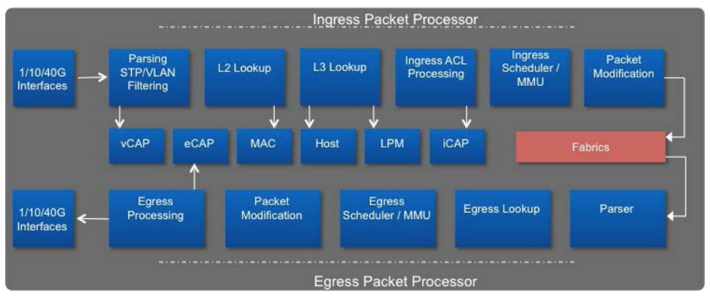
Example fixed forwarding pipeline

Slide 13
Fixed pipeline in hardware: Tomahawk 3
Broadcom Tomahawk 3
~ Dec 2017
StrataXGS BCM56980
12.8 terabits per second (Tbps)
128x100Gbps / 64x200Gbps / 32x400Gbps
~ 8 billion packets per second (0.04 nsec/packet)
500ns or 300ns latency
Relatively small forwarding tables
Relatively shallow buffers
Lean feature set
Data plane is not programmable

Slide 14
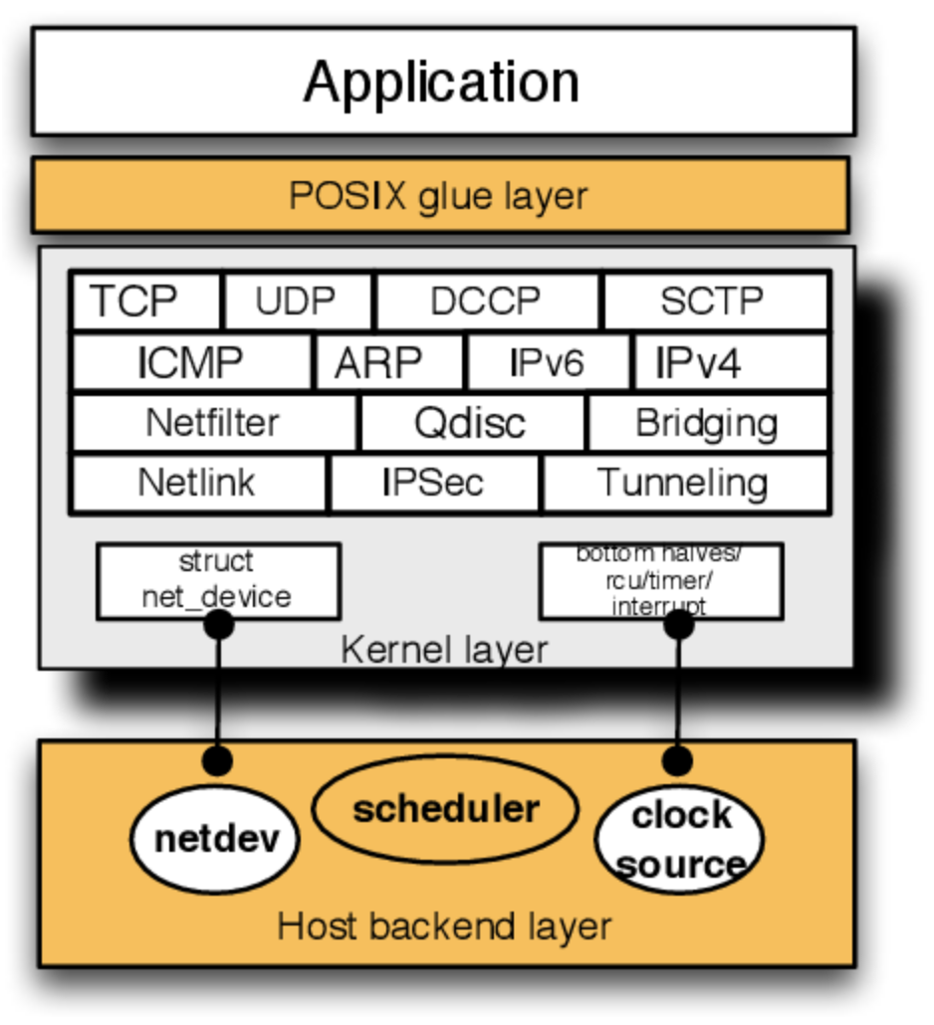
Fixed pipeline in software: Linux kernel stack
Legacy Linux networking stack
Linux can be configured to be a software switch
Ethernet, IPv4, IPv6, VLANs, ACLs, …
Everything implemented in software (with option for hardware acceleration)
Socket interface to send and receive packets (inet sockets, raw sockets)
Socket interface to populate the forwarding tables and to configure options (netlink sockets)
Note: recent versions of Linux have a programmable network stack (discussed later)

Slide 15
Data plane considerations
Optimize for (trade-off):
Cost
Throughput
Latency
Buffer depth
Table sizes (routes, ACLs,…)
Features (protocols, telemetry, …)
Flexibility (programmability)
Power (cooling)
Density
Constrained by:
Die size limits (800 mm²)
Process geometry
Internal / external memory
IO speed (SERDES)
Power dissipation
Development cost
Device cost
Time to market

Slide 16
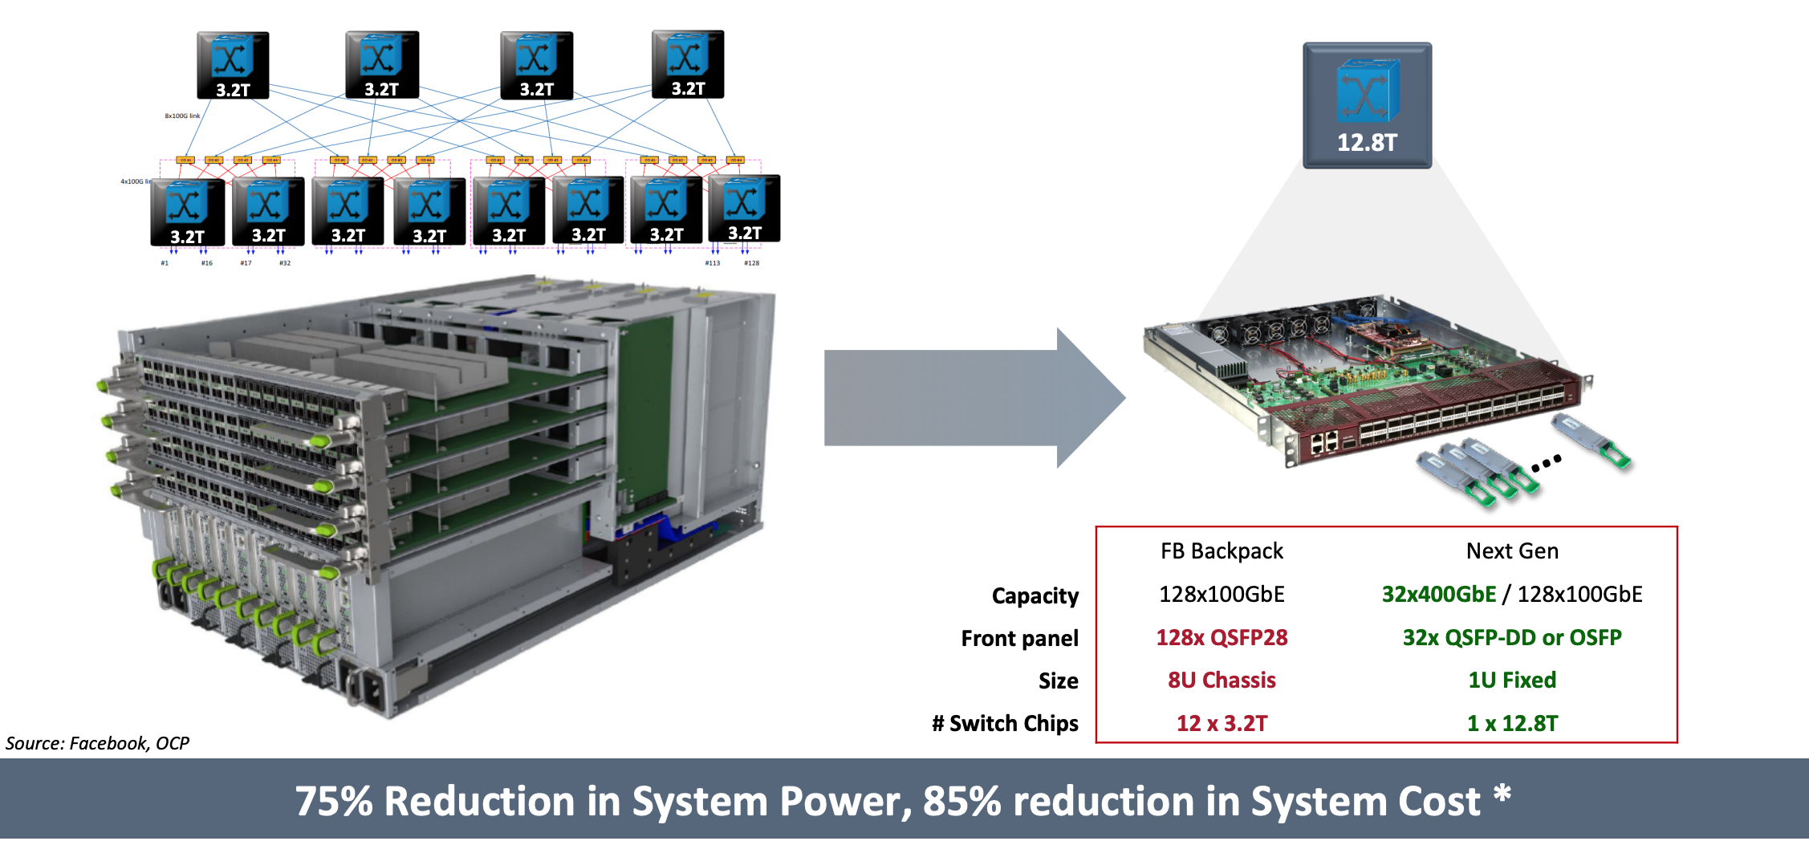
Single-stage versus multi-stage data plane

Slide 17
Section 3 Programmable classical data plane
( Using P4 as the main example )

Slide 18
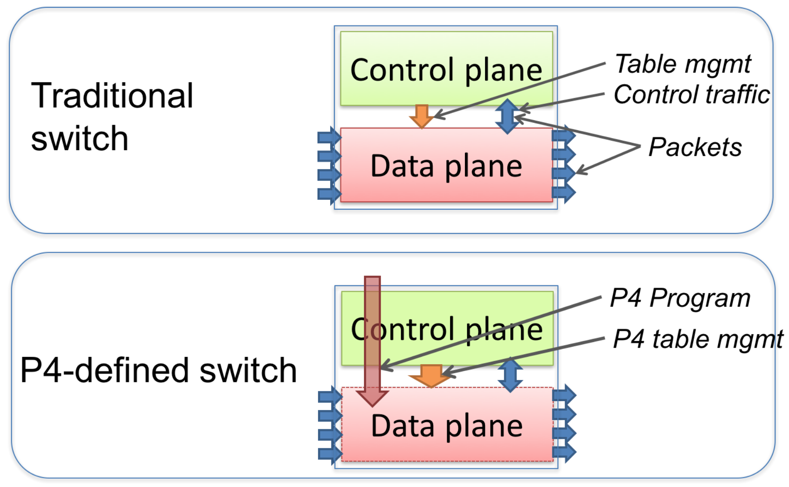
Programmable pipeline vs fixed pipeline

Slide 19
Controllable vs automated quantum nodes
Definitions from “A Link Layer Protocol for Quantum Networks”:
Controllable node: offers the possibility to perform controllable quantum operations as well as storing qubits. Specifically, these nodes enable decision making
Automated node: are typically only timing controlled, i.e. they perform the same preprogrammed action in each time step.
Actions fixed in hardware
Pipeline fixed in hardware,
Controlled by tables
Tables populated by software
Fixed match-action architecture + set of offload blocks
Programmable pipeline
Programmable pipeline
+
Service plane
Fully programmable
Possibly using specialized instruction set
Determines boundary between control plane and data plan

Slide 20
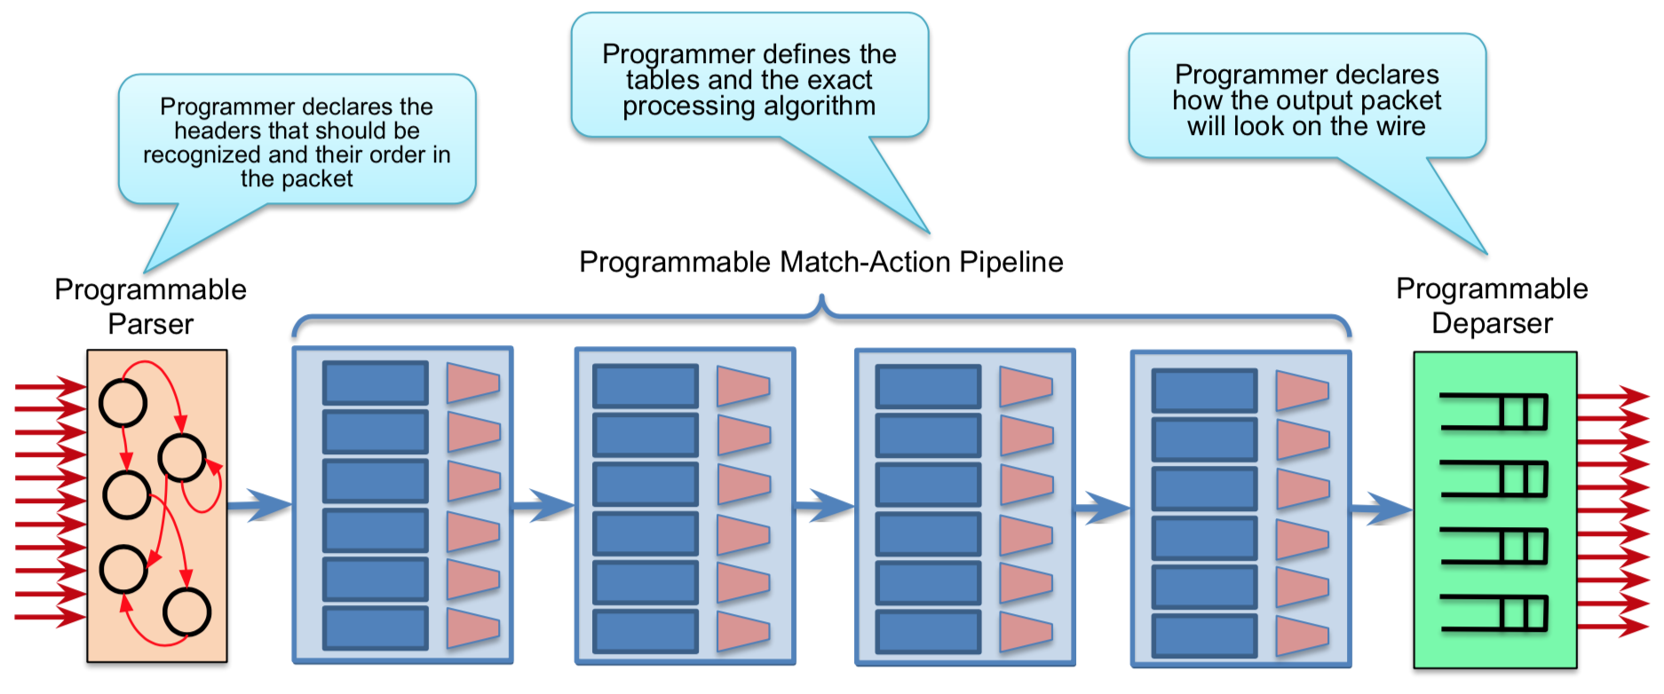
Parser, match-action tables, de-parser

Slide 21
Advantages of a programmable pipeline
Ability to make the data plane do what you want it to do
Ability to define new data plane protocols
Remove unused data plane protocols (reduced complexity)
Flexible and efficient use of table resources
Greater visibility (new telemetry protocols)
Software-style of development
Keep your own ideas
The data plane for quantum networks is not yet well-defined!
So we absolutely need a programmable data plane

Slide 22
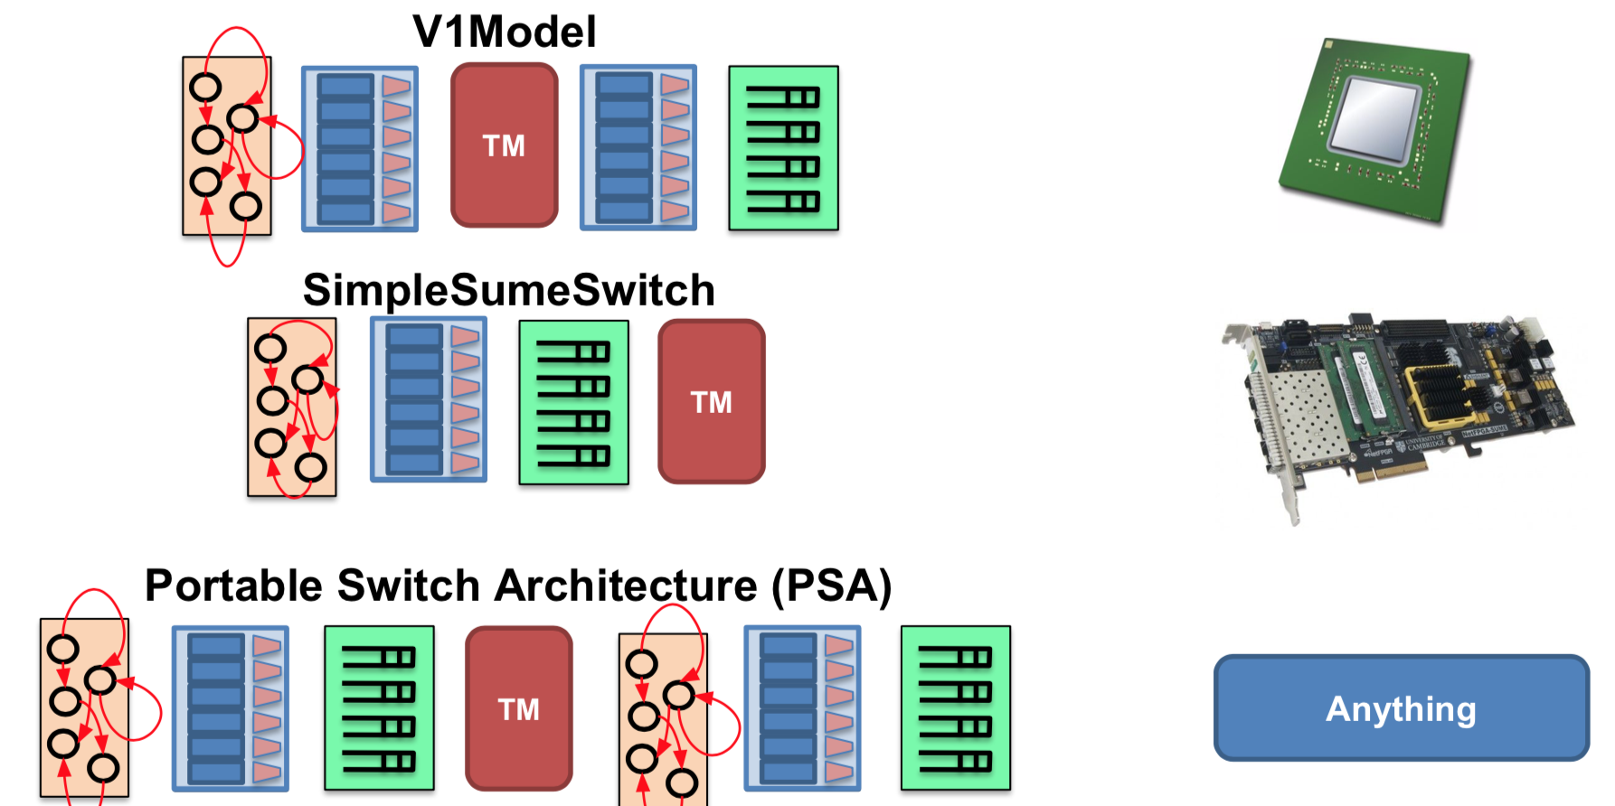
Architectural diversity of P4 targets

Slide 23
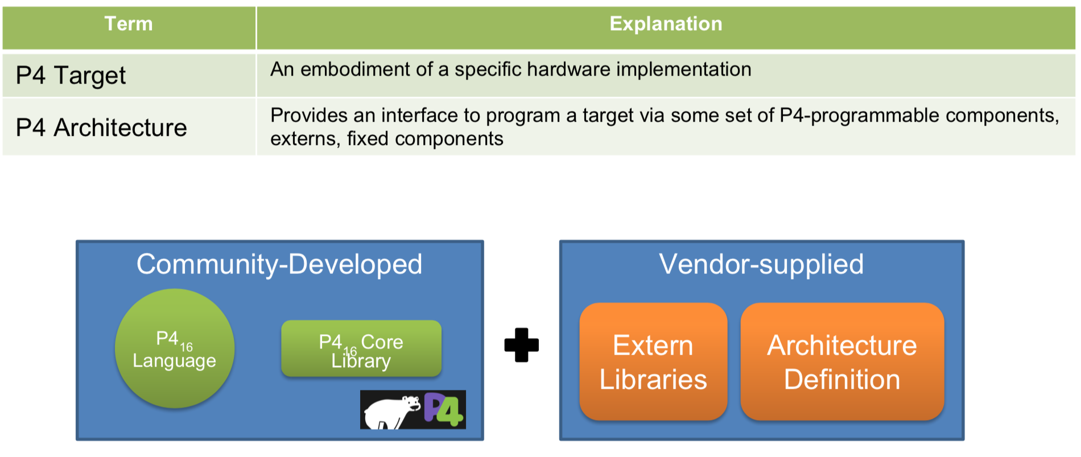
P4 architecture definition and externs library

Slide 24
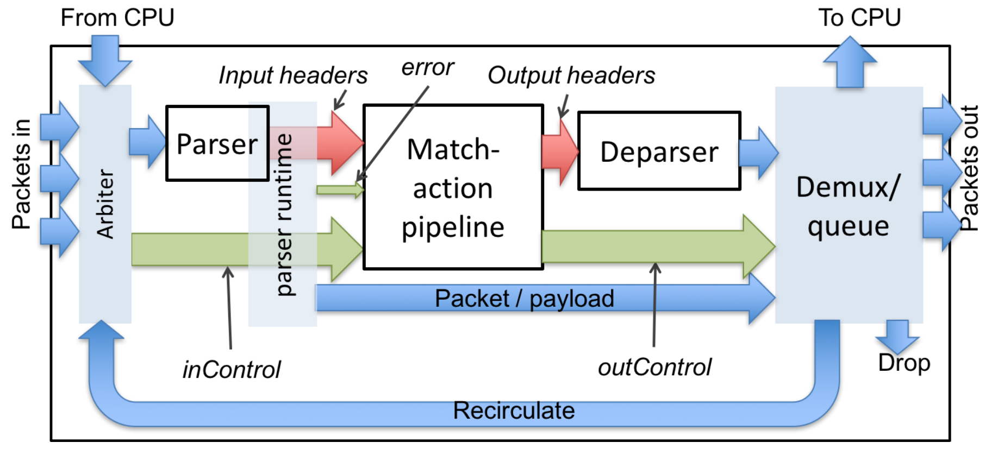
Very simple switch architecture

Slide 25
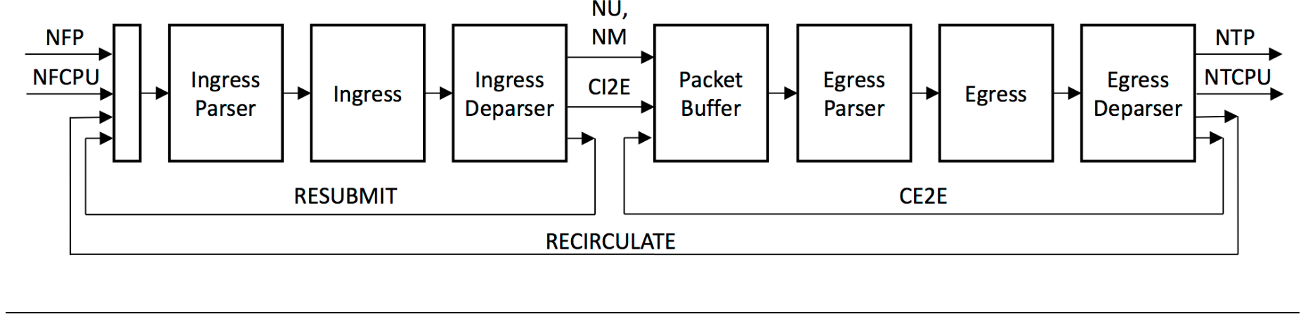
Portable Switch Architecture (PSA)
Architecture definition
Externs library
Packet Replication
Engine
Buffering
and Queueing
Engine
Hashes
Checksums
Counters
Meters
Registers
Random
Action Profile
Action Selector
Timestamp
Packet Digest

Slide 26
Portable Switch Architecture (PSA)
Architecture definition
Can we define a
Portable Quantum
Switch Architecture
(PQSA)
?
Externs library
Packet Replication
Engine
Buffering
and Queueing
Engine
Hashes
Checksums
Counters
Meters
Registers
Random
Action Profile
Action Selector
Timestamp
Packet Digest

Slide 27
Example P4 header definitions
header Ethernet_h {
EthernetAddress dstAddr;
EthernetAddress srcAddr;
bit<16> etherType;
}
header IPv4_h {
bit<4> version;
bit<4> ihl;
bit<8> diffserv;
bit<16> totalLen;
bit<16> identification;
bit<3> flags;
bit<13> fragOffset;
bit<8> ttl;
bit<8> protocol;
bit<16> hdrChecksum;
IPv4Address srcAddr;
IPv4Address dstAddr;
}

Slide 28
Example P4 meta data definitions (structs)
Architecture defined meta-data
Program defined meta-data
struct psa_egress_input_metadata_t {
ClassOfService_t class_of_service;
PortId_t egress_port;
PSA_PacketPath_t packet_path;
EgressInstance_t instance;
Timestamp_t egress_timestamp;
ParserError_t parser_error;
}
struct psa_egress_output_metadata_t {
bool clone;
CloneSessionId_t clone_session_id;
bool drop;
}
struct Parsed_packet {
Ethernet_h ethernet;
IPv4_h ip;
}

Slide 29
Example P4 parser (state machine)
parser TopParser(packet_in b, out Parsed_packet p) {
state start {
b.extract(p.ethernet);
transition select(p.ethernet.etherType) {
0x0800: parse_ipv4;
}
}
state parse_ipv4 {
b.extract(p.ip);
verify(p.ip.version == 4w4, error.IPv4IncorrectVersion);
verify(p.ip.ihl == 4w5, error.IPv4OptionsNotSupported);
transition accept;
}
}

Slide 30
Example P4 control block (match-action tables)
control TopPipe(inout Parsed_packet headers,
in error parseError,
in InControl inCtrl,
out OutControl outCtrl) {
...
action Set_nhop(IPv4Address ipv4_dest, PortId port) {
nextHop = ipv4_dest;
headers.ip.ttl = headers.ip.ttl - 1;
outCtrl.outputPort = port;
}
...
table ipv4_match {
key = { headers.ip.dstAddr: lpm; } // longest-prefix match
actions = {
Drop_action;
Set_nhop;
}
size = 1024;
default_action = Drop_action;
}

Slide 31
Example P4 control block (apply section)
...
apply {
...
// Lookup destination IPv4 address in IPv4 route table to determine next-hop
ipv4_match.apply();
if (outCtrl.outputPort == DROP_PORT) return;
// Lookup remaining TTL in TTL table to decide whether to punt to CPU
check_ttl.apply();
if (outCtrl.outputPort == CPU_OUT_PORT) return;
// Lookup next-hop IP address in dmac table to determine destination MAC address
dmac.apply();
if (outCtrl.outputPort == DROP_PORT) return;
// Lookup outgoing port in smac table to determine source MAC address
smac.apply();
}
}

Slide 32
Programmable pipeline hardware (P4)
Barefoot Tofino 2 (Now Intel)
~ Jan 2019
12.8 Tbps
Rich feature set
Programmable using P4 high-level language https://p4.org

Slide 33
Programmable pipeline hardware (vendor-specific)
Broadcom Trident 4
~ June 2019
StrataXGS BCM56880
12.8 terabits per second (Tbps)
Rich feature set
Programmable using NPL high-level language https://nplang.org/

Slide 34
Programmable pipeline in software: Linux eBPF

Slide 35
Section 4 Control plane - data data interface

Slide 36
What interface are we talking about?

Slide 37
Disaggregation and open interfaces
Router
Router
Control Plane
Control Plane
Vendor A
Proprietary Interface
Open Interface
Data Plane
Data Plane
Vendor B
Monolithic closed
single-vendor
router
Disaggregated open
multi-vendor
router

Slide 38

“Standard” control plane - data plane interfaces
NETLINK
ForCES

Slide 39
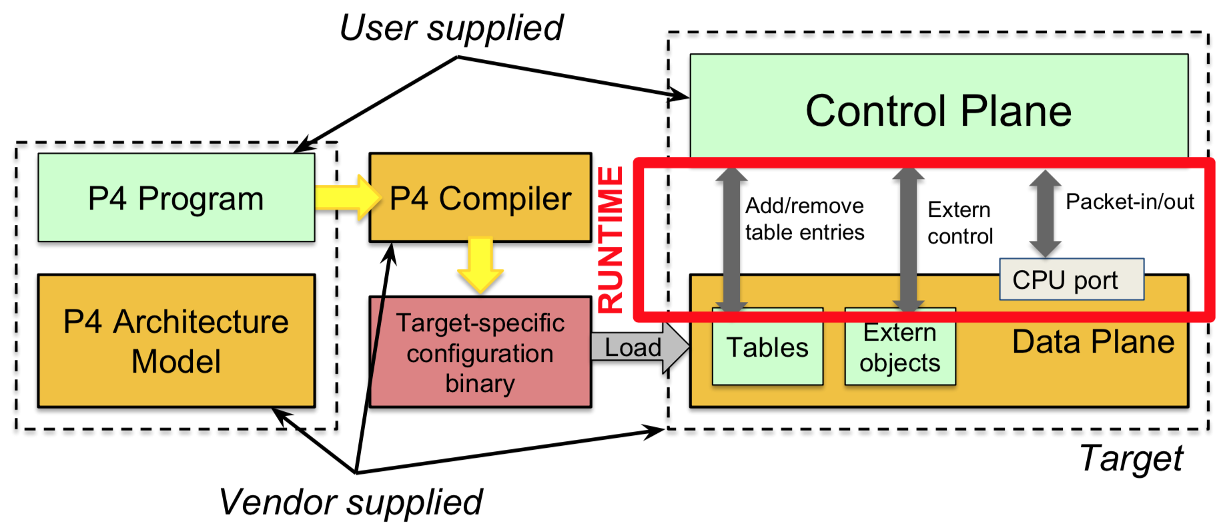
P4 runtime project

Slide 40
Section 5 Programmable quantum data plane

Slide 41
Quantum planes (centralized control plane) Helpful to think of RWA in OTN networks as an analogy
Quantum Controller
Aware of end-to-end network service
Aware of full traffic demand matrix (rate)
Aware of required fidelity
Aware of technology model
Computes optimal paths and schedules
Translates to network primitives
Control Plane
Quantum
Forwarding Element
Interface
Some protocol to program primitives into data plane
Service Plane
Quantum
Forwarding Element
Classical Data Plane
Quantum
Forwarding Element
Implements local behavior
Expressed in simple primitives
Two data planes: classical and quantum
Data plane will probably be modeled using state machines and scheduled timeslots to drive entanglement attempts and local operations (e.g. swap attempts)
Something akin to “service plane” probably needed to implement stateful datalink protocols
Service Plane
Quantum Data Plane
Service Plane
Classical Data Plane
Classical Data Plane
Quantum Data Plane
Quantum Data Plane
Heralding station
Notes:
Out-of-band vs in-band.

Slide 42
Quantum planes (distributed control plane)
Quantum
Forwarding Element
Control
Plane
New quantum routing and signaling protocols
Quantum
Forwarding Element
Quantum
Forwarding Element
Service Plane
Control
Plane
Control
Plane
Classical Data Plane
Ideally, same interface
that is used by the
centralized control
plane protocol
Service Plane
Quantum Data Plane
Service Plane
Classical Data Plane
Classical Data Plane
Quantum Data Plane
Quantum Data Plane
Heralding station
Notes:
Out-of-band vs in-band.

Slide 43
Key questions for the quantum data plane
What are the right abstractions for the quantum data plane?
Abstract enough to abstract away the details of the underlying technology
Rich enough to expose all capabilities of the underlying technology
What service primitives does the quantum data plane offer?
Generate point-to-point entangled Bell Pairs, swaps, error correction, distillation, resource discovery and management (e.g. number of memory qubits and characteristics)
What is the interface between the quantum control plane and the quantum data plane?
How do we make the quantum data plane programmable?
Can we re-use / generalize existing mechanisms (e.g. P4) for the quantum data plane API / programming?

Slide 44
Some additional interesting observations
Qubits do not have headers nor payload
Protocol “headers” must be in associated classical messages
But received qubits do have implicit meta-data: incoming port and timeslot
Qubits can only be stored for a very short time (decoherence)
The network layer protocol needs to optimize for using entanglement as soon as possible
Any involvement of the control plane is out of the question (local and datalink operations only)
There are many widely diverging candidate technologies for the quantum data plane
Need a very strong abstraction layer for the data plane
Quantum data plane protocols are very stateful (as opposed to stateless IP/Ethernet)
Match-action tables and registers are probably too simple
Probably need an NPU akin to the service layer to process datalink protocols. “Punt to service”
The control plane must be aware of the distributed nature of Bell Pairs and the physical model of the technology: noise models, loss models, etc.
But the data plane can probably get away without know any of this (analogy with OTN)
The quantum data plane is inherently uni-directional
Quantum repeaters only send qubits.
Heralding stations only receive qubits.
Entanglement success is reported in a classical message.

Slide 45
Primitive operations in the quantum data plane
Classical data plane
Re-use existing classical architecture (parser, match-action tables, de-parser)
Probably need an NPU to implement datalink protocols (akin to service plane)
Quantum data plane
Primitives to send and receive qubits for local entanglement attempts
Primitives for local operations
What is the right level of abstraction for local operations?
Unitary gates?
Or higher level abstractions such as swap attempts, distillation attempts, etc.
Where on the spectrum between controllable and automated are the quantum nodes?
Routers vs repeaters vs heralding stations?

Slide 46
Some initial thoughts on a possible abstraction Timeslot schedules (similar to GMPLS + TDM)
2
-
-
5
-
1
5
4
5
-
-
-
1
4
2
3
-
5
-
-
3
-
-
-
5

Slide 47
A possible optimization to minimize lost opportunities due to decoherence Timeslot schedules and state machines
State:
try-both-paths
1-5 entanglement
success
State:
finish-path-1
2
2
-
-
5
-
-
-
-
-
1-5 entanglement
de-cohere: 1-4 end-to-end failed
1
5
4
1
5
4
5
-
-
-
1
4
2
3
-
5
-
-
-
-
-
-
4
4
4
4
5
5
5
5
5-4 entanglement
success:
1-5 <> 5-4 swap
1-4 end-to-end pair produced
3
3
-
-
-
5
-
-
-
-

Slide 48
P4 seems promising for quantum data plane
P4 is is extremely flexible extensible
We probably can use P4 for the quantum data plane with no or little language syntax changes
Use concept of ”architecture packages” to represent unique characteristics of quantum router hardware pipeline
“Programmable Quantum Switch Architecture” equivalent of PSA
Concept of “externals” to represent unique quantum hardware components
Swap attempts, distillation attempts, move to/from storage qubit, decoherence events, possibly individual gates, …
Represent received qubit as empty packet with only implicit meta-data (port and timeslot)

Slide 49
Thank you.

